Slide 1
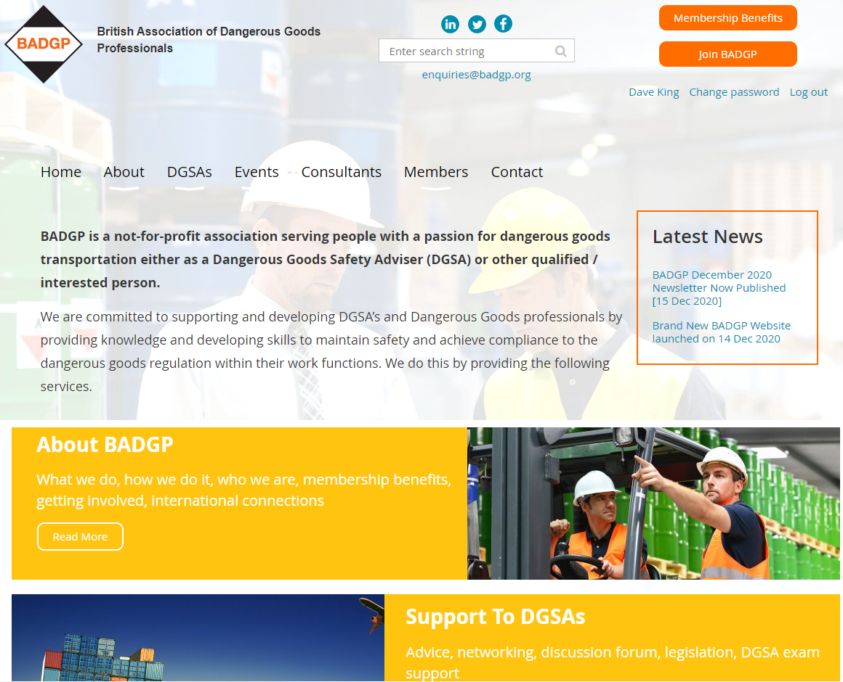
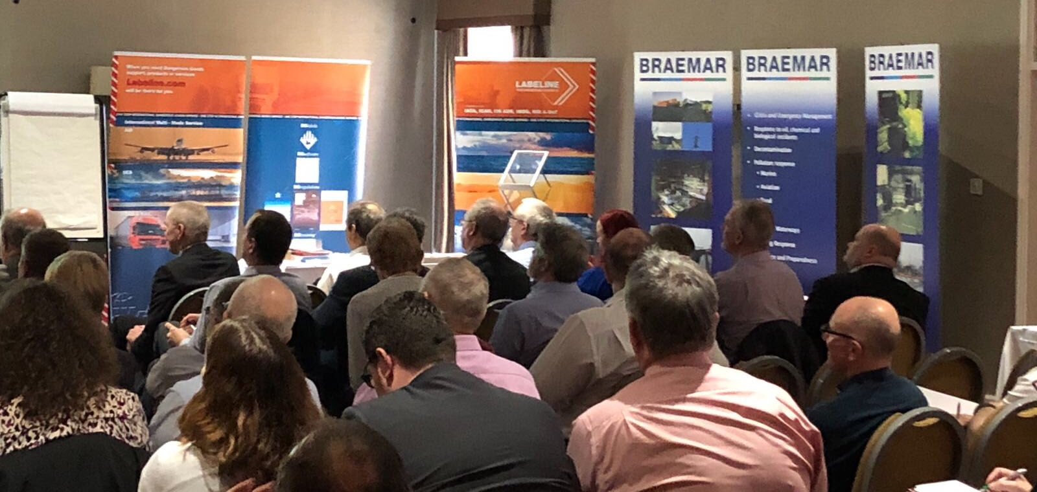
British Association of
Dangerous Goods Professionals
Organisation run by DG professionals for DG Professionals
Seminars, Webinars, Newsletters
Support, Advice, Guidance to develop & expand your knowledge
Email: enquiries@badgp.org
Website: www.badgp.org

